Slide 1

Test Taker
Project Created By:
Justin Goulet; Chris Childers, Steven Clark, John Orcino, Jeremy Pietersma, Christian Mathias

Slide 2
Presentation Outline
Project Management
Requirement Analysis
Design Patterns
Imperative Class
Implementation

Slide 3
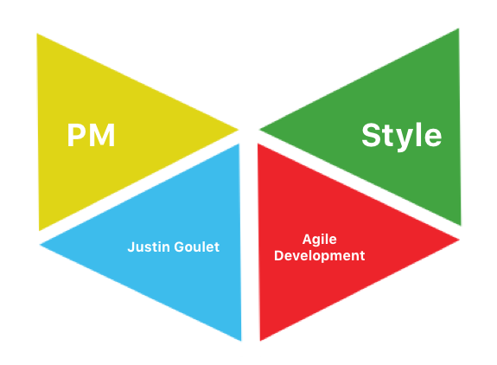
Project Management
Project Manager: | Justin Goulet
UI Designers: | Chris Childers
 | Justin Goulet
 | Jeremy Pietersma
Backend Developers: | Steven Clark
 | John Orcino
Analytics: | Christian Mathias
 | John Orcino

Slide 4
Requirement Analysis
Summary of Project -
To create a Test-Taking application that can be used for content management and studying. We prioritized the basics of functionality and simplicity.
Group-Set Requirements -
Flash Cards | Course Management | Study Games | Ease of Use
Clean Design | Mac / Windows Capable | Efficient | Single-User Database

Slide 5
Requirement Analysis Cont...
Use Cases Accomplished:
Add Course
Select Courses
Click add course
Name your course and save it
Click save
Delete Course
Select Courses
Select the Course you wish to delete
Click Delete Course
Click yes on pop-up window
Create Quiz
Select Courses
Select Course
Click Manage Selected Course
Click Add Quiz
Name your quiz and save it
Delete Quiz
Select Courses
Select Course
Click Manage Selected Course
Select Quiz to delete
Click delete Quiz
Click yes on pop-up window
Create Question
Select Courses
Select Course
Click Manage Selected Course
Select Quiz you want to add question to
Click Manage Selected Quiz
Click Add Question
Type in Question and answers
Click save question

Slide 6
Requirement Analysis Cont...
Use Cases Accomplished cont...
Delete Question
Select Courses
Select Course
Click Manage Selected Course
Select Quiz you want to delete question from
Click Manage Selected Quiz
Select Question to delete
Click Delete Question
Click yes to delete
Take Quiz
Select Study Tools
Click Take Quiz
Select Quiz
Click Take Quiz
Answer each question
When done click submit and finish
Take Flashcard set
Select Study Tools
Click Practice Flashcards
Select Flashcard set (bases questions from previously created quiz)
Click Take Flashcard set
Toggle button to show/hide answer
Click next question to keep practicing
Click exit flashcard set to complete
Statistics
Select “Statistics”
Adjust Report Options
Date
Time Frame (Hourly)
Event Type
Hit “Analytics” Button to generate report
Close report pop-up when finished

Slide 7
Requirement Analysis Cont...
Additional Features - Use Cases:
Administration Login System
Login with specific user info
New options available depending on user
Scheduling/Calendar Implementation
Click Calendar
Select Date of which you have a Test
Add test to that day of calendar
App would remind you of test date and to study
Study Game
Quiz Questions would be imported
Questions would be made into a game for an additional study option
Users would see a question and a drop down with all possible answers.
The user selects the ‘correct’ answer from the box. If they are correct, time is added, if not, time is removed. Each correct questions adds points. The player plays until score is improved.

Slide 8
RA - Analytics
The Analytics Classes Must Be:
Non-intrusive
Minimal impact on performance
Portable
Usable on any project
Practical
Provides common user data
Easy to implement

Slide 9
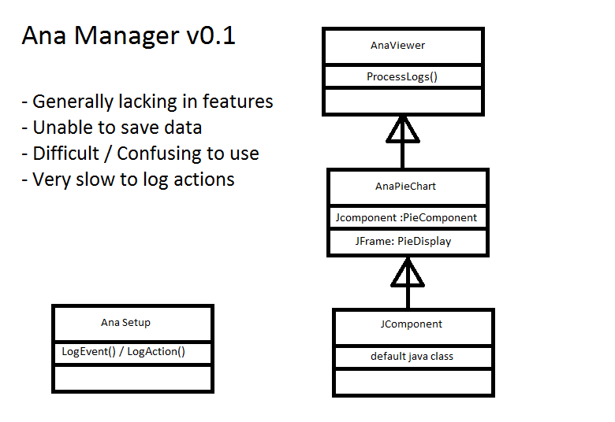

Slide 10
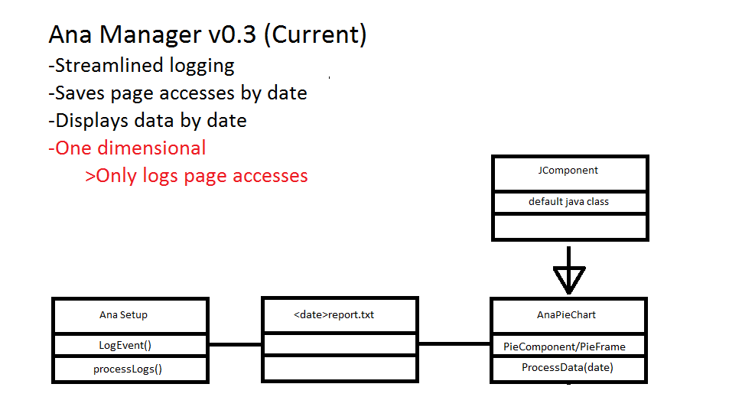

Slide 11
Imperative Class
LibraryController
UUID strings mapped to Registerable(or implementing) objects
First implemented with HashMaps, then database
Pseudo-singleton, Java 8 allows fully functional completely static class
Traditional singleton pattern would reduce readability.
Database access through JDBC
Actual database source wrapped into connect() easy to change to multi-user
PreparedStatements don’t require string composition.

Slide 12
Implementation
Design:
SideMenu - Controlled by PageManager: Determines what page to go to when clicked
CustomPage - Has built-in, custom, navigation controller that allows user to go back to previous pages. Also creates templates for each page type.
CustomButtons - Created default button style, to be fluent among different pages
Backend:
Basic Types: Question, Test, Course, CourseProgress, most manipulation done here
Independent: many-to-many, reusable
e.g. Questions can be reused in final
Registerable: each returns a primary key
Library Controller: Retrieves and stores types by primary key

Slide 13
Conclusion

